Slide 1
Chapter Two Model View Controller, GUI Components, Events

Slide 2
Learning Objectives
Structure our code using the Model-View-Controller architecture
Use various GUI components
Define and use Styles and Themes
Handle Events

Slide 3
Tip Calculator
Model-View-Controller
GUI components
TextView, EditText, Button
XML attributes
Styles and Themes
Events and Event Handling

Slide 4
Model View Controller (1 of 2)
Model: the functionality of the app
View: The graphical user interface
Controller: The middleman between the Model and The View
The user interacts with the View, the Controller sends new data to the Model and asks for some calculations, then displays the result in the View.

Slide 5
Model View Controller (2 of 2)
Model: TipCalculator.java (the TipCalculator class)
View: activity_main.xml
Controller: MainActivity.java (the MainActivity class)

Slide 6
Model
In this app, we keep the Model to a minimum.
It includes a tip percentage, a bill, and methods to compute the tip and the total bill.

Slide 7
The Model
Example 2.1 shows the Model for this app, the TipCalculator class.
Note that it does not include any GUI-like code. It could be reused for another app, or even a desktop Java application.

Slide 8
View
The View reflects the data that are stored in the Model.
It includes GUI components, also called widgets, to gather user input from the user (the tip and the bill), and to display the tip and the total bill.

Slide 9
GUI Components
GUI components can:
Display data
Capture user input
Allow the user to interact with them, which can trigger some action, i.e., a call to a method

Slide 10
Some GUI Components (1 of 2)
Component | Class
Panel | View
Keyboard | KeyboardView
Label | TextView
Text field | EditText

Slide 11
Some GUI Components (2 of 2)
Component | Class
Button | Button
Radio button | RadioButton
Checkbox | CheckBox
2-state button | ToggleButton
On-off switch | Switch

Slide 12
GUI Components
View is the root GUI component.
The other GUI components inherit from View, either directly or indirectly.
View is in the android.view package.
Most GUI components are in the android.widget package.

Slide 13
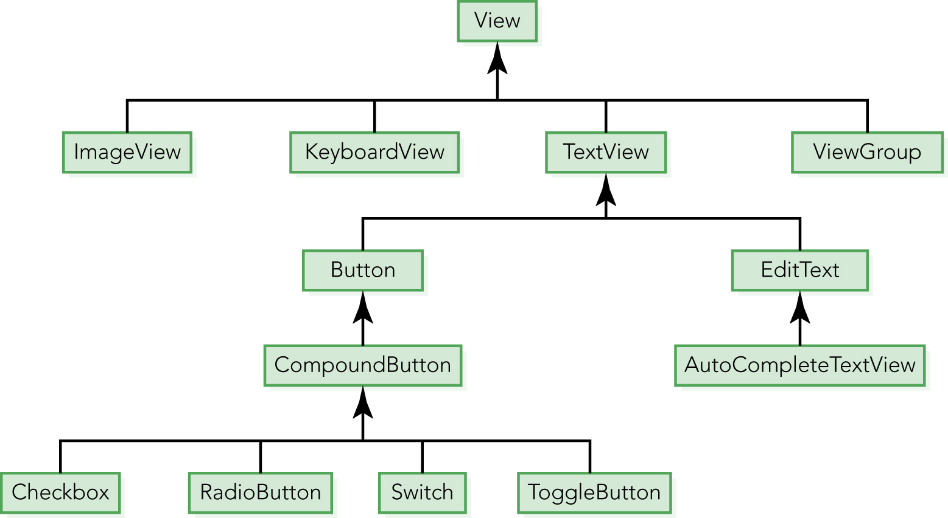

Slide 14
Version 0
To keep things simple, we only allow the app to run in vertical orientation.
➔ in the AndroidManifest.xml file, inside the activity element, we add an android:screenOrientation attribute and assign to it the value portrait.

Slide 15
AndroidManifest.xml
…
<activity …
android:screenOrientation="portrait" > …
</activity>

Slide 16
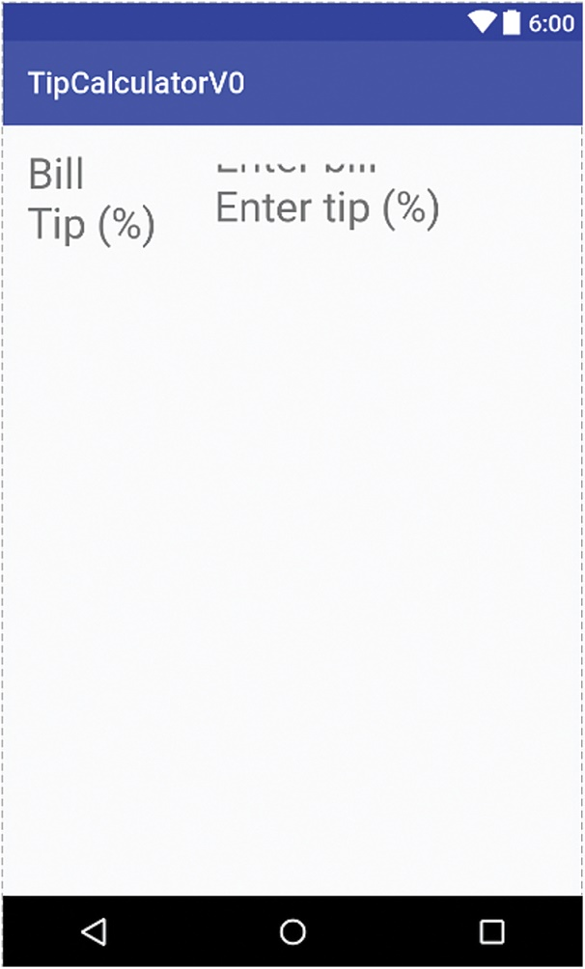
Version 0 Preview
Note the less than perfect positioning.

Slide 17
Version 0 (1 of 4)
We only display the components:
Two EditTexts for the bill and the tip percentage
Two TextViews to display labels for the above EditTexts

Slide 18
Version 0 (2 of 4)
We modify the activity_main.xml file so that it has two EditText and two TextView elements inside the RelativeLayout element.

Slide 19
Version 0 (3 of 4)
For all widgets, we start by defining the android:layout_width and android:layout_height attributes.

Slide 20
Version 0 (4 of 4)
We set the width and height of the RelativeLayout to match_parent (that is actually the default for the skeleton code).
We set the width and height of the four GUI components to wrap_content: the GUI components are only as big as necessary to contain their contents.

Slide 21
Layout Parameters
Generally, a layout class contains a static inner class, often called LayoutParams, that contains XML attributes that allows us to arrange the components within the layout.

Slide 22
RelativeLayout
If static class B is an inner class of class A, we refer to it using A.B
➔ We use the attributes of RelativeLayout.LayoutParams to position the XML elements.

Slide 23
Identifying XML Elements (1 of 3)
In order to position an XML element (A – representing a GUI component) relative to another XML element (B – also representing a GUI component), we need to be able to reference B.
➔ the android:id attribute allows us to give an id to an XML element.

Slide 24
Identifying XML Elements (2 of 3)
The syntax for assigning an id to an XML element is
android:id = "@+id/idValue"
For example:
android:id = "@+id/amount_bill"

Slide 25
Identifying XML Elements (3 of 3)
Assigning an id to an XML element helps us position the GUI components represented by these XML elements relative to each other.
It also allows us to retrieve the corresponding GUI components (using the findViewById method—more on this later).

Slide 26
RelativeLayout.LayoutParams
Some attributes include (more in Table 2.5)
android:layout_alignLeft
android:layout_alignRight
android:layout_alignBottom
android:layout_alignTop
android:layout_above
android:layout_toLeftOf
…..

Slide 27
Relative Positions
<TextView android:id="@+id/label_bill"
…
<EditText android:id="@+id/amount_bill" android:layout_toRightOf="@+id/label_bill" android:layout_alignBottom="@+id/label_bill"
…

Slide 28
Positions of the Four GUI Components
TextView for the bill: the top left corner of the screen
EditText for the bill: to the right of the TextView for the bill
TextView for the tip percentage: below the TextView for the bill
EditText for the bill: to the right of the TextView for the tip percentage
➔ See Example 2.3

Slide 29
Version 0 (1 of 3)
For all elements of the two EditText, we want to constrain the user to only input valid values, i.e., floating point numbers.
We do this by using the android:inputType attribute, assigning the value numberDecimal to it.
<EditText .. android:inputType="numberDecimal" .. />

Slide 30
Version 0 (2 of 3)
We want to tell the user what to enter in the two EditTexts.
➔ We use the android:hint attribute
Its value will show in light gray, looking like a hint
android:hint="@string/amount_bill_hint"

Slide 31
Version 0 (3 of 3)
For the android:text values of the two TextViews and the android:hint values of the two EditTexts, we use string values defined in strings.xml

Slide 32
The Four Strings in strings.xml
<string name = "label_bill">Bill</string>
<string name = "label_tip_percent">Tip (%)</string>
<string name = "amount_bill_hint">Enter bill</string>
<string name = "amount_tip_percent_hint">Enter tip
</string>

Slide 33
Version 1
In Version 1, we add GUI components and use colors.
We add a red line and four more TextViews (label and display View for the tip amount and total), as well as a button (to trigger the calculations).

Slide 34
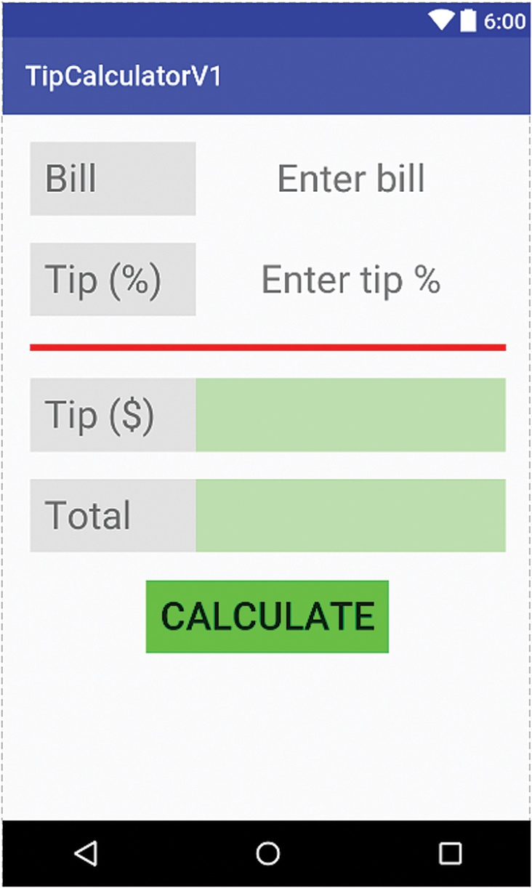
Version 1 Preview

Slide 35
Version 1
We can use many attributes to specify how a GUI component will look.
For example, we can specify the background of a component, its foreground color, its text style, its size, the margins around it, or the padding inside it.

Slide 36
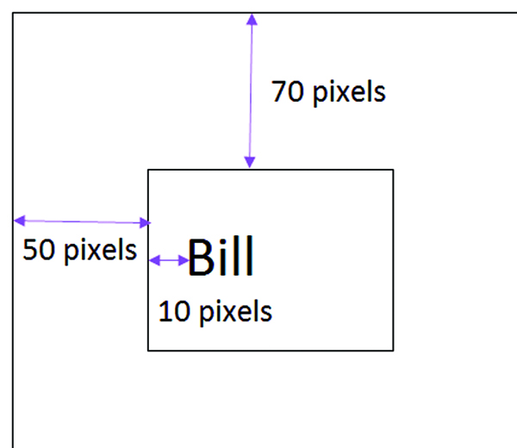
Margins and Padding
The top margin is 70.
The left margin is 50.
The left padding is 10.

Slide 37
Version 1 (1 of 2)
We can also specify the margins around a component.
Attribute Name | Related Method | Description
android:layout_marginBottom | setMargins( int, int, int, int ) | Set extra space at the bottom of this View
android:layout_marginLeft | setMargins( int, int, int, int ) | Set extra space at the left of this View
android:layout_marginRight | setMargins( int, int, int, int ) | Set extra space at the right of this View
android:layout_marginTop | setMargins( int, int, int, int ) | Set extra space at the top of this View

Slide 38
Version 1 (2 of 2)
We can also specify the padding inside a component.
Attribute Name | Related Method | Description
android:paddingBottom | SetPadding( int, int, int, int ) | Set the padding, in pixels, of the View’s bottom edge
android:paddingLeft | SetPadding( int, int, int, int ) | Set the padding, in pixels, of the View’s left edge
android:paddingRight | SetPadding( int, int, int, int ) | Set the padding, in pixels, of the View’s right edge
android:paddingTop | SetPadding( int, int, int, int ) | Set the padding, in pixels, of the View’s top edge

Slide 39
More XML Attributes
Attribute | Class | Description
android:background | View | A drawable resource, for example an image or a color
android:textColor | TextView | The text color
android:textSize | TextView | The text size
android:textStyle | TextView | The text style (bold, ..)

Slide 40
android:textColor (1 of 5)
Values for the android:textColor attribute can be either a string representing an RGB color, a resource, or a “theme” attribute.
The string can have many formats:
“#aarrggbb” ➔ aa is the alpha value
“#rrggbb” ➔opaque
“#argb” ➔ equivalent to “#aarrggbb”
“#rgb” ➔ opaque

Slide 41
android:textColor (2 of 5)
Examples:
android:textColor = “#FF49AF32”
android:textColor = “#05F300”
android:textColor = “#C348”
android:textColor = “#4CA”

Slide 42
android:textColor (3 of 5)
Another way to define a color is to use a resource id using this syntax ([ ] ➔optional)
"@[+][package:]type:name"
Assuming that we have created the file colors.xml in the res/values directory
android:textColor="@color/lightGreen"

Slide 43
android:textColor (4 of 5)
android:textColor="@color/lightGreen"
The lightGreen variable needs to be defined in the colors.xml file (or another file) of the res/values directory
<color name="lightGreen">#40F0</color>

Slide 44
android:textColor (5 of 5)
<color name="lightGreen">#40F0</color>
color is a type of resource, lightGreen is its name, and its value is 40F0

Slide 45
activity_main.xml
Example 2.6 (activity_main.xml) shows many attributes for various GUI components and a variety of ways to specify their value.
Example 2.5 shows the colors.xml file.

Slide 46
Inserting a Line to Separate GUI Components
We can define a line as an empty View with a background color and a thickness
<View
…
android:layout_height="5dip"
android:layout_width="match_parent"
…
android:background="#FF00" />

Slide 47
Version 2
Next, we use styles and themes to organize our project better.
Styles and themes enable us to separate the look and feel of a View from its content.
This is similar to the concept of CSS (Cascading Style Sheets) in web design.

Slide 48
Styles (1 of 2)
We can define styles in a file named styles.xml in the res/values directory.
The syntax for defining a style is
<style name="nameOfStyle" [parent="styleThisStyleInheritsFrom"]>
<item name =
"attributeName">attributeValue</item>
...
</style>

Slide 49
Styles (2 of 2)
<style name="nameOfStyle" [parent="styleThisStyleInheritsFrom"]> <item name="attributeName"> attributeValue
</item>
...
</style>
The (optional) parent attribute allows us to create a hierarchy of styles, i.e., styles can inherit from other styles.

Slide 50
A Generic Style for Views Containing Text
<style name="TextStyle" parent="@android:style/TextAppearance"> <item name = "android:layout_width">wrap_content</item> <item name = "android:layout_height">wrap_content</item> <item name = "android:textSize">32sp</item> <item name = "android:padding">10dp</item>
</style>
This style specifies width, height, text size, and padding.

Slide 51
A Style Inheriting from TextStyle
We can now define style for Buttons that inherit from the TextStyle style, using the parent attribute, and specify more attribute/ value pairs
<style name="ButtonStyle"
parent="TextStyle">
…
</style>

Slide 52
ButtonStyle
<style name="ButtonStyle" parent="TextStyle">
<item name="android:background">
@color/darkGreen
</item>
</style>

Slide 53
Styles.xml
Example 2.8 shows the complete styles.xml file, defining TextStyle, LabelStyle, CenteredTextStyle, InputStyle, OutputStyle, and ButtonStyle.
Figure 2.7 shows the inheritance hierarchy.

Slide 54
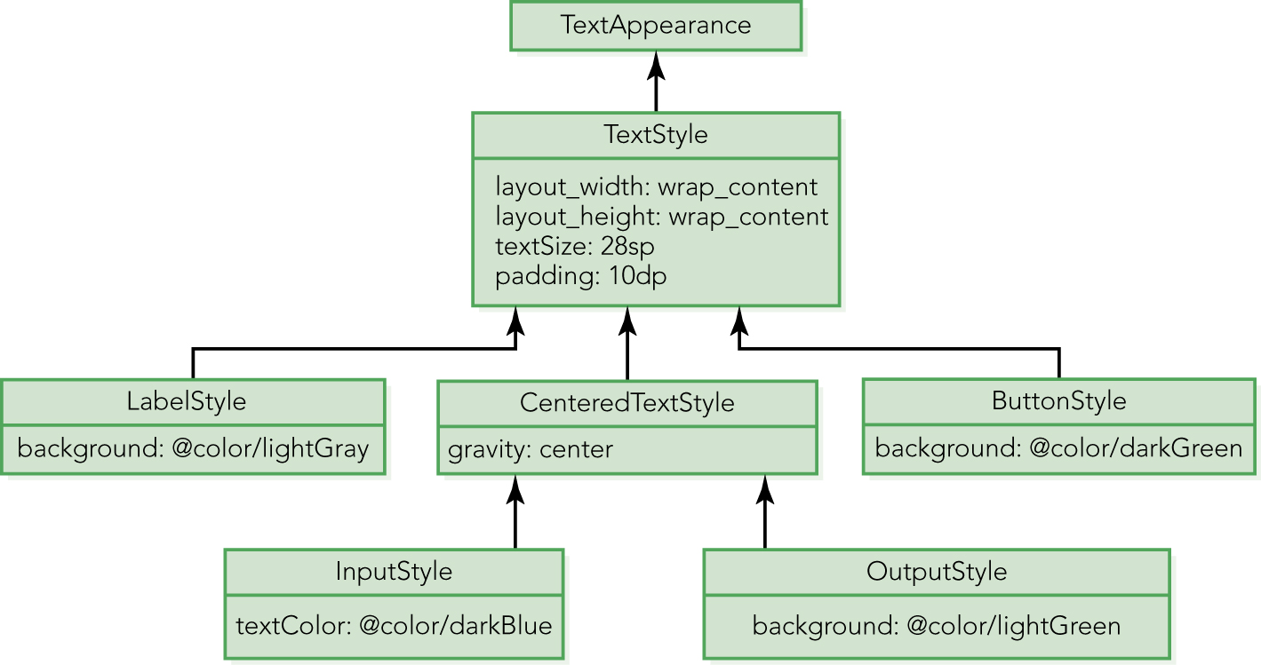

Slide 55
Using a Style (1 of 2)
Now that we have defined styles in styles.xml, we can style a GUI component using the style attribute using this syntax:
style = "@style/nameOfStyle"

Slide 56
Using a Style (2 of 2)
In order to style an EditText using the InputStyle style, we write (in the activity_main.xml file)
<EditText
… style="@style/InputStyle"
…

Slide 57
Benefits of Using Styles (1 of 2)
If we decide to change the background color of the "Output" TextViews in the app, we only need to do it in one place, the styles.xml file.

Slide 58
Benefits of Using Styles (2 of 2)
As Example 2.9 shows, the activity_main.xml is now much simpler and much easier to understand
Inside activity_main.xml, we can now focus on how the GUI components are organized

Slide 59
Themes (1 of 4)
A style relates to a GUI component or a View.
A theme relates to an activity; it can even relate to the whole app.
We can “theme” an app with a style by editing the AndroidManifest.xml file, changing the android:theme attribute of its application element using this syntax:
android:theme="@style/nameOfStyle"

Slide 60
Themes (2 of 4)
<application android:allowBackup="true" android:icon="@drawable/ic_launcher" android:label="@string/app_name" android:theme="@style/LabelStyle" >
…

Slide 61
Themes (3 of 4)
To "theme" a whole app, we can also edit the AppTheme style inside the styles.xml file.
We can “theme” an activity with a style by editing the AndroidManifest.xml file, adding an android:theme attribute to an activity element using the same syntax as before:
android:theme="@style/nameOfStyle"

Slide 62
Themes (4 of 4)
<activity
android:name=".MainActivity" android:label="@string/app_name" android:theme="@style/LabelStyle"
…

Slide 63
Events and Event Handling
In Version 3, we handle events.
When the user clicks on the button, we update the value of the tip and the total bill to reflect the values of the tip percentage and bill that the user entered or edited via the keyboard.

Slide 64
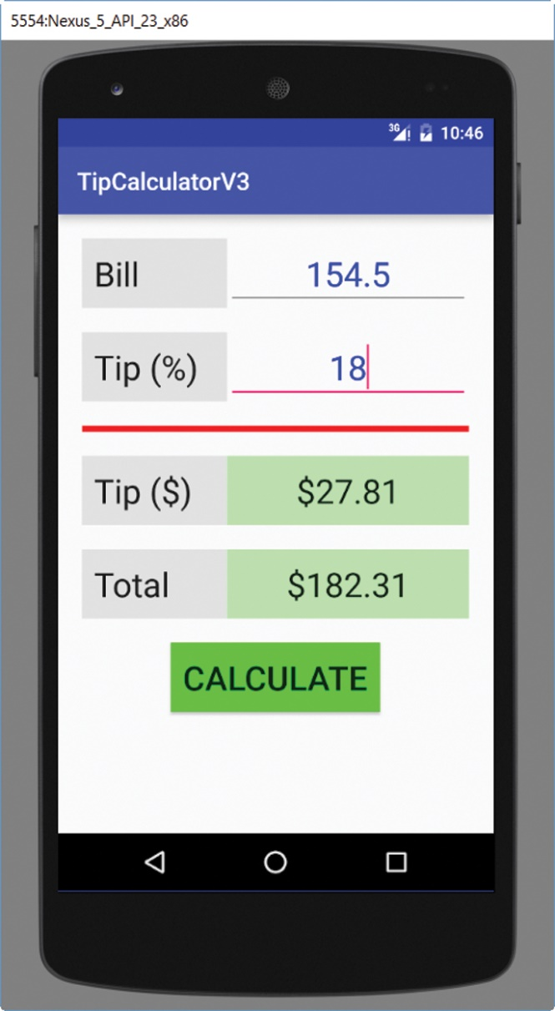
Version 3

Slide 65
Using the Model
In order to update the tip percentage and the bill and calculate the tip and total bill, we use the Model, the TipCalculator class.
Thus, inside the Activity class, we declare an instance variable of type TipCalculator.
private TipCalculator tipCalc;

Slide 66
Setting Up Event Handling (1 of 4)
We can set up event handling in the layout file (xml).
We can also set up event handling by code (Java).
In Version 3, we do it in the layout xml file.
In Version 4, we do it by code.

Slide 67
Setting Up Event Handling (2 of 4)
To set up a click event on a View, we use the android:onClick attribute of the View and assign to it a method.
android:onClick="methodName"
If the method is named calculate (see Example 2.10).
android:onClick="calculate"

Slide 68
Setting Up Event Handling (3 of 4)
The event will be handled inside that method, which must have the following API
public void methodName( View v )
v is the View where the event happened.
If the method is called calculate:
public void calculate( View v )

Slide 69
Setting Up Event Handling (4 of 4)
When the user clicks on the button, we execute inside calculate, and its View parameter is the Button; if we have the following statement inside calculate:
Log.w( "MainActivity", "v = " + v );
Inside LogCat, we have something like:
v = android.widget.Button@425a2e60
The value above identifies the Button.

Slide 70
Event Handling (1 of 2)
Inside the calculate method, we need to retrieve the bill and the tip percentage in order to calculate the tip and the total bill.
The android framework enables us to assign an id to a View so that we can retrieve that View using its id; we assign an id to a View using the android:id attribute.

Slide 71
Event Handling (2 of 2)
We already assigned ids to the various GUI components in the activity_main.xml file.
Indeed, we used their ids to position the GUI components relative to each other.

Slide 72
The EditText ids
<EditText android:id="@+id/amount_bill" …
<EditText android:id="@+id/amount_tip_percent"
…

Slide 73
The TextView ids
<TextView android:id="@+id/amount_tip"
…
<TextView android:id="@+id/amount_total"
…

Slide 74
Retrieving a View Using Its id (1 of 4)
We can get a reference to a View that has been given an id using the findViewById method of the Activity class, which has this API:
View findViewById( int id )
findViewById returns the View with the specified id within the View controlled by the Activity.

Slide 75
Retrieving a View Using Its id (2 of 4)
We call the findViewById method inside an Activity class using this syntax:
findViewById( R.id.idValue )
findViewById returns the View that is part of the layout xml file that was inflated in the onCreate method of the Activity class.

Slide 76
Retrieving a View Using Its id (3 of 4)
The findViewById method returns a View; so if we expect to retrieve a TextView and we want to assign the View retrieved to a TextView, we need to cast the View returned by findViewById to a TextView:
TextView tipTextView = ( TextView ) findViewById( R.id.amount_tip );

Slide 77
Retrieving a View Using Its id (4 of 4)
EditText billEditText = ( EditText )
findViewById( R.id. amount_bill );
EditText tipEditText = ( EditText )
findViewById( R.id.amount_tip_percent );
TextView tipTextView = ( TextView )
findViewById( R.id. amount_tip );
TextView totalTextView = ( TextView )
findViewById( R.id. amount_total );

Slide 78
Capturing User Input
The method getText of the EditText class returns an Editable (an interface)
We can call the toString method of Editable to get a String
String tipString =
tipEditText.getText( ).toString( );

Slide 79
Using the Model (1 of 2)
Once we have the user inputs as Strings, we convert them to floats using the parseFloat method of the Float wrapper class.
Then we use the various methods of the Model (the TipCalculator class) to set the tip percentage and bill value of the tipCalc instance variable.
Then we calculate the tip and total value.

Slide 80
Using the Model (2 of 2)
float billAmount = Float.parseFloat( billString );
int tipPercent = Integer.parseInt( tipString );
tipCalc.setBill( billAmount );
tipCalc.setTip( .01f * tipPercent );
tipTextView.setText( "" + tipCalc.tipAmount( ) );
totalTextView.setText( "" + tipCalc.totalAmount( ) );

Slide 81
More Event Handling
We actually do not need a button for this app.
Pressing a key is an event ..
.. so every time the user presses a key, i.e., changes either the tip percentage or the bill, we can handle that event and update the tip and total bill accordingly.

Slide 82
More Event Handling—Version 4
In Version 4, we set up the event by code, in the Activity class.
Thus, we delete the Button element in the xml file.

Slide 83
Listening to Key Events (1 of 4)
The TextWatcher interface, from the android.text package, provides three methods to handle key events: beforeTextChanged, onTextChanged, and afterTextChanged.
These methods are automatically called when the text inside a TextView changes (provided that event handling is set up).

Slide 84
Listening to Key Events (2 of 4)
We actually want to handle key events inside the two EditTexts.
The EditText class is a subclass of TextView, therefore, an EditText “is a” TextView.
Thus, we can use TextWatcher with EditTexts.

Slide 85
Listening to Key Events (3 of 4)
Generally, to capture and handle an event, we need to do the following:
Code an event handling class (typically implementing a listener interface).
Declare and instantiate an object of that class.
Register that object on one or more GUI components.

Slide 86
Listening to Key Events (4 of 4)
Thus, in order to use TextWatcher so that we get notified that a key event is happening inside one of the two EditTexts, we:
Code a class that implements the TextWatcher interface.
Declare and instantiate an object of that class.
Register that object on the two EditTexts.

Slide 87
Implementing TextWatcher (1 of 6)
Because we need to access the two EditTexts in several methods (onCreate to set up event handling and when we handle the event), we declare them as instance variables.
We also declare the two TextViews as instance variables.
Inside onCreate, we use findViewById to assign a value to all four components.

Slide 88
Implementing TextWatcher (2 of 6)
We first code a private inner class implementing TextWatcher.
That class needs to implement the three methods of TextWatcher: beforeTextChanged, onTextChanged, and afterTextChanged.

Slide 89
Implementing TextWatcher (3 of 6)
We update our View after the key event happened, so we are only interested in afterTextChanged .. but we must implement all three (when inheriting from an interface, it is mandatory to implement all its methods).
So we implement beforeTextChanged and onTextChanged as “do-nothing” method.

Slide 90
Implementing TextWatcher (4 of 6)
private class TextChangeHandler implements TextWatcher {
public void beforeTextChanged( CharSequence s,
int start, int count, int after ) { }
…
}

Slide 91
Implementing TextWatcher (5 of 6)
public void onTextChanged( CharSequence s, int start, int before, int after ) {
}
public void afterTextChanged( Editable e ) { calculate( );
}

Slide 92
Implementing TextWatcher (6 of 6)
Note that calculate no longer takes a View parameter; it is not needed because we do not care about the origin of the event (i.e., which EditText is being edited).
The code inside calculate is the same as before.

Slide 93
Setting Up Event Handling (1 of 2)
Now that our event handling class is coded, we need to declare and instantiate an object of that class inside the onCreate method.
TextChangeHandler tch =
new TextChangeHandler( );

Slide 94
Setting Up Event Handling (2 of 2)
We now register the listener on the two EditTexts (inside onCreate).
billEditText.addTextChangedListener( tch );
tipEditText.addTextChangedListener( tch );

Slide 95
Running Version 4
When running Version 4 of this app, every time we edit either the tip percentage or the bill, the tip and the total value are automatically updated.

